Slide 1

IDENTIFYING EMERGING TRENDS FROM SOCIAL MEDIA POSTS
Using Dynamic Clustering to Analyze Diverse Datasets
Presented by
Jubair hossain
Ishrat Mahjeerin Neha

Slide 2

INTRODUCTION
Social media generates massive amounts of data, reflecting trends and opinions in real time. This project aims to collect diverse posts from various platforms and use dynamic clustering to identify emerging topics and patterns. These insights can guide decision-making in an ever-changing digital landscape.

Slide 3

PROBLEM STATEMENT
Challenges:
Vast and unstructured social media data.
Rapidly changing trends and topics.
Need for dynamic, scalable analytical models.

Slide 4

DATA COLLECTION STRATEGY
Twitter
Use APIs to extract posts (ensure compliance with platform policies).
Apply filters for relevance (keywords, hashtags, geolocation).
Clean data (remove duplicates, handle missing values).
Instagram
Facebook
Reddit

Slide 5


DATA CHARACTERISTICS
Dataset Features:
Textual data (posts, comments).
Metadata (timestamp, platform, user engagement metrics).
Diversity Factors:
Demographics (language, region).
Topics (news, entertainment, technology, etc.).

Slide 6

DYNAMIC CLUSTERING MODEL
Approach:
Preprocessing:
Tokenization, stop-word removal, and stemming/lemmatization.
Vectorization (TF-IDF, word embeddings).
Clustering Algorithm:
K-Means, DBSCAN, or Hierarchical Clustering.
Evaluate optimal cluster numbers using the Elbow Method or Silhouette Score.
Dynamic Adjustment:
Regularly update model with new data.
Incorporate time-series analysis for emerging trends.

Slide 7






RESULTS & INSIGHTS
Predicting Disease Outcomes
Algorithmic Securities Trading
Clustering accuracy (internal evaluation metrics like Silhouette Score).
Trend discovery rate (new vs. established topics).
Sentiment and engagement analysis.
Predictive Tools Maintenance
Personalized Recommendations & Cart Management
Autonomous Vehicles (Hybrid)
Energy Consumption Optimization

Slide 8

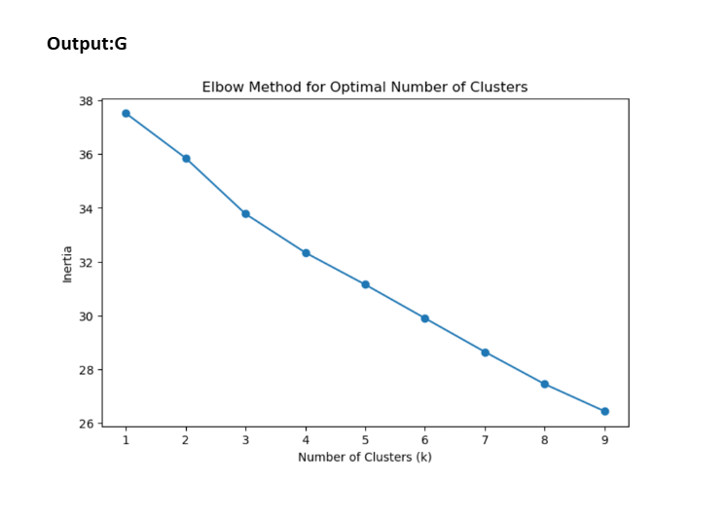
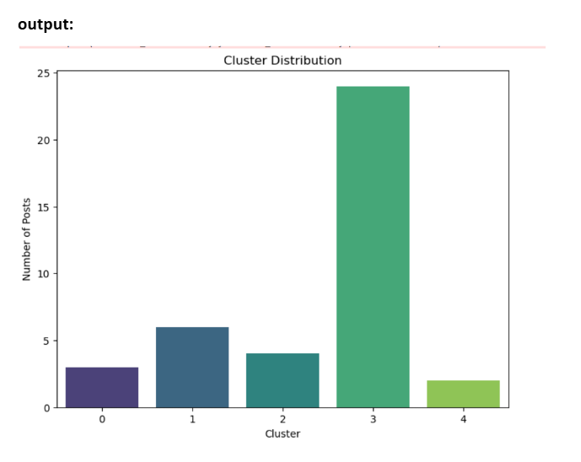
visual representation of data

Slide 9
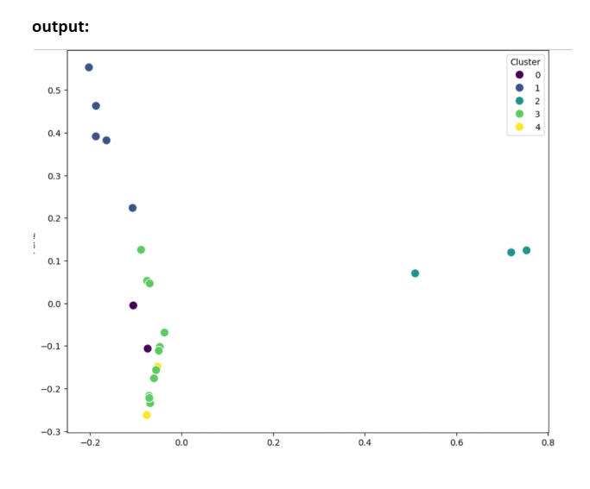
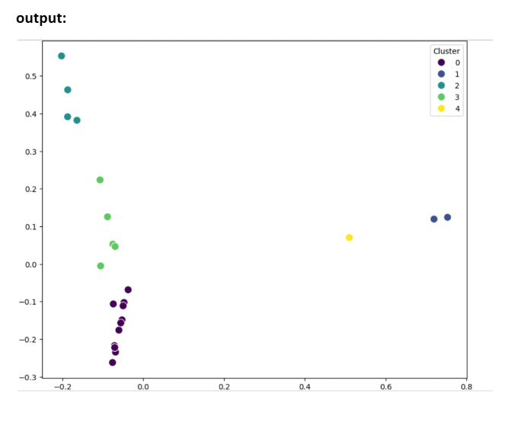
visual representation of data

Slide 10

CONCLUSION
Social media analysis through dynamic clustering reveals emerging trends and topics in real-time. This approach provides valuable insights for businesses, researchers, and decision-makers, enabling proactive strategies in a rapidly evolving digital world

Slide 11

THANK YOU

